Slide 1

BioGPT: Generative Pre-trained Transformer for Biomedical Text Generation and Mining
Renqian Luo, Liai Sun, Yingce Xia, Tao Qin, Sheng Zhang, Hoifung Poon, and Tie-Yan Liu
Microsoft Research, October - 2022
Bhautik Lukhi
Advanced AI in Biomedicine(Graded)
21st November, 2024

Slide 2
Agenda
Motivation
Biomedical NLP Tasks
BERT and GPT
Introduction to BioGPT
Architecture, Training and Fine-tuning
Results on Biomedical Tasks
BioGPT in Action

Slide 3
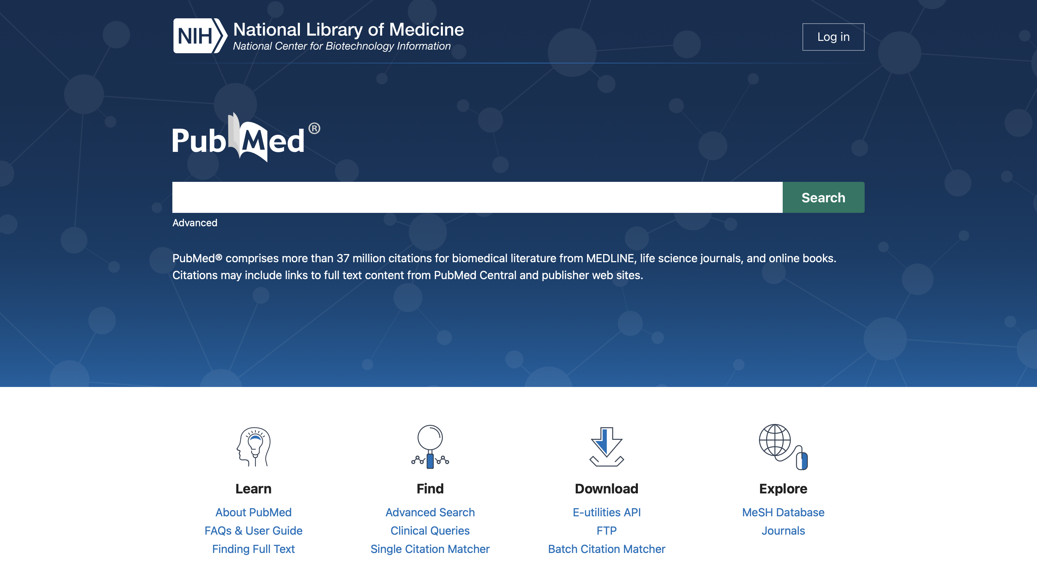
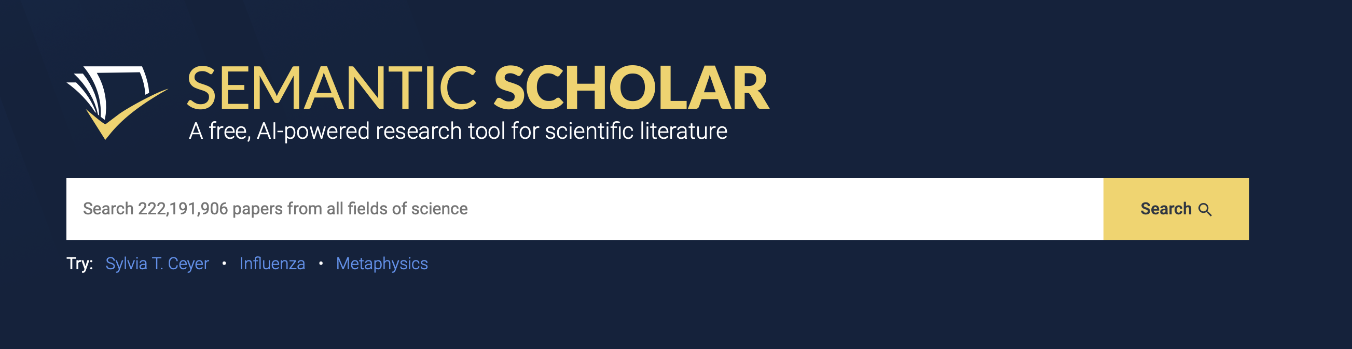
Why
Millions of Research Articles
PubMed
Semantic Scholar
PMC
Arxiv
…..
PubMed
SEMANTIC SCHOLAR
Notes:
37M+ articles at this moment on PubMed and every day around 3000+ new articles are published.
So it calls for automated Knowledge Discovery.
1.5 million new items are added each year right now (i.e., more than two papers per min

Slide 4
NLP in Biomedicine
Great at extracting insights from structured/unstructured biomedical text.
Exceptional capabilities in complex language understanding and generation tasks.
Applications:
Drug discovery
Clinical therapy enhancement
Pathology research
Notes:
Drug Discovery and Development
Challenge: Identifying new therapeutic targets or repurposing existing drugs is data-intensive.
Clinical Therapy Enhancement
Personalized Medicine: Tailors treatments by analyzing patient and genetic data.
Therapy Gaps: Identifies under-researched areas for therapy improvement.
Physician Support: Offers instant evidence-based treatment recommendations.
Pathology Research
Data Extraction: Automates key insights from pathology reports (e.g., tumor staging, biomarkers).
Disease Mechanisms: Links genes, proteins, and diseases through literature analysis.
Biomarkers: Identifies or validates biomarkers for diagnosis and treatment.

Slide 5
Biomedical NLP Tasks
Relation Extraction: Identifying relationships between entities in text.
Question Answering: Providing answers based on biomedical literature.
Document Classification: Categorizing documents into predefined classes.
Text Generation: Generating relevant biomedical text based on prompts.
Named Entity Recognition: Identifying and classifying key entities.
Text Summarization: Condensing lengthy articles into concise summaries.
Notes:
Entities could be drug, target, disease etc.
QA given the context, can also do Zero shot learning.
Document in terms of BDA; provides the contextual information needed to discover, understand, access and reuse research data.
Text generation plays a crucial role in NLP tasks, such as language translation, sentiment analysis, text summarization, and question answering.
BioGPT was evaluated on six key biomedical NLP tasks:

Slide 6
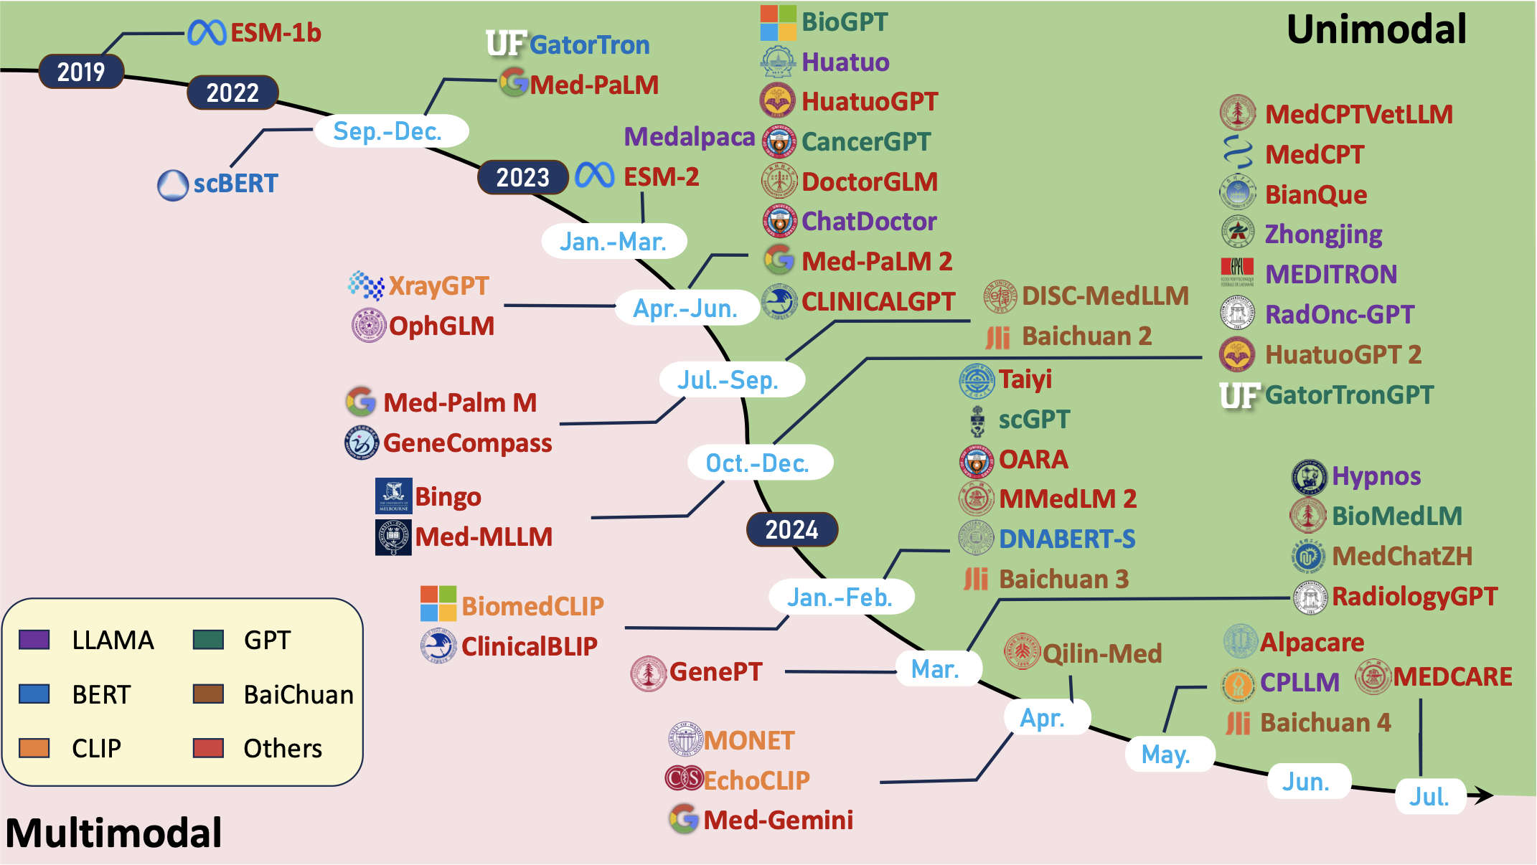
A Survey for Language Models in Biomedicine (Wang et al. 2024)
Notes:
The release of ESM-1b, an early model leveraging transformer architectures for tasks in biomedical NLP. This marked the beginning of using advanced machine learning for biomedical language.
BioGPT's release followed the trend of transformer-based architectures that focus on domain-specific language processing tasks.
LLAMA and GPT: Focus on text generation with causal transformers; GPT is more mature with applications like ChatGPT.
BERT: Focuses on language understanding with bidirectional transformers.
CLIP: Specializes in vision-language tasks, bridging text and images.
BaiChuan: A multilingual, efficient, and open-source alternative similar to LLAMA but developed in China.

Slide 7
Pre-trained models for Bio-medicine
Model | Pros | Cons
BERT | Pretrained on massive data | General Domain
BioBERT | Continue pre-trained on bio domain | Shared vocab with general domain
BlueBERT | Continue pre-trained on bio domain | Shared vocab with general domain
SciBERT | Pretrained on Science domain | Out-domain knowledge
PubMedBERT | Pretrained on bio domain | Encoder only architecture
ELECTRAMed | Pretrained on bio domain | Encoder only architecture
*until November, 2022
Notes:
Electra : Instead of masking tokens (like BERT), ELECTRA replaces some tokens in the input with incorrect ones (generated by a smaller generator model).

Slide 8
BERT and GPT

Slide 9
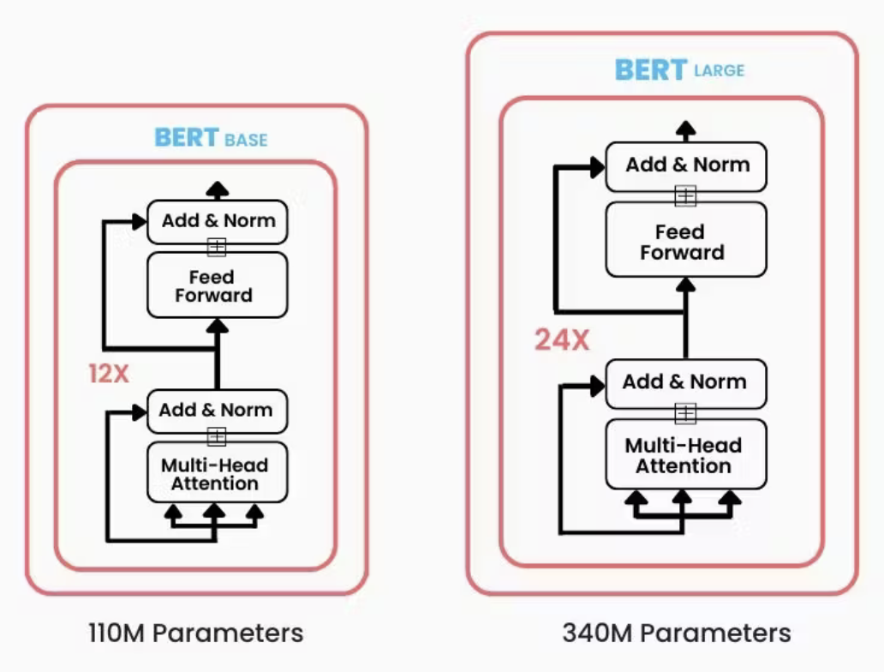


BERT and GPT
BERT: Pre-trained on English Wikipedia and BooksCorpus.
GPT: Pre-trained Transformer pre-trained on BookCorpus.
Self-Supervision:
Masked Language Modeling: Predicting masked words based on full context.
Causal language modeling: Predicting the next word of the sentence based only on the past.
BERT (Base) and BERT (Large).
Notes:
BERT - October 2018, GPT - June 2018.
Utilizes large-scale unlabeled data through self-supervised tasks to learn representations, then fine-tuned for downstream tasks.
BERT :use the BooksCorpus (800M words) and English Wikipedia (2.5B words)
BooksCorpus contains over 7,000 unique unpublished books from a variety of genres.

Slide 10
Where BERT Lacks?
BERT’s Constraints:
Better at understanding rather than generating text.
GPT's Generative Edge:
Better at language generation through a causal language modeling.
GPT-2 and GPT-3 enhance performance on multiple downstream tasks.
Multi-task and also Few-shot learner.
Notes:
BERT
Utilizes a transformer encoder architecture, limiting its generative capabilities.
Understanding tasks (e.g., classification, sentiment analysis.
Generative tasks (e.g., text completion, summarization).
The decoder processes input in a causal, unidirectional manner, only looking at preceding words. It cannot use future words to generate the next token.
Multi-task Learner: A model capable of handling multiple tasks (e.g., translation, summarization, classification) simultaneously by sharing knowledge across tasks.
Few-shot Learner: A model that performs well on new tasks with minimal examples (a few labeled samples) by leveraging pre-trained knowledge.

Slide 11
Why not use GPT Directly in Biomedicine?
Even GPT-3 struggles with biomedical tasks due to the Domain Shift.
Previous Adaption Attempt:
DARE: Pre-trained on limited data (0.5M abstracts) for data augmentation in relation extraction.
But results were limited.
Task-Specific Adaptation(InstructGPT): GPT model adapted for unconventional downstream clinical tasks.
Notes:
GPT models excel in general domains but struggle in biomedical tasks due to the significant domain differences.
Traditional models (e.g., BERT) are strong at understanding but weak at generative tasks.
Unconventional downstream tasks:
Span Identification: Extracting specific segments of text that correspond to clinical entities or information.
Token-Level Sequence Classification: Classifying individual tokens within a sequence to identify their roles or categories in a clinical context.

Slide 12
Introduction to BioGPT

Slide 13
What is BioGPT?
A generative pre-trained Transformer for biomedical text, trained on 15M PubMed abstracts.
Key Features:
Combines generative modeling with biomedical relevance.
Can be used for Relation extraction, Question Answering, Document classification, and Text generation.
Notes:
We collected all the PubMed items that were updated before
2021 from the official site. then filtered
out all the empty items with only title but no abstract. Then left with 15M items.

Slide 14
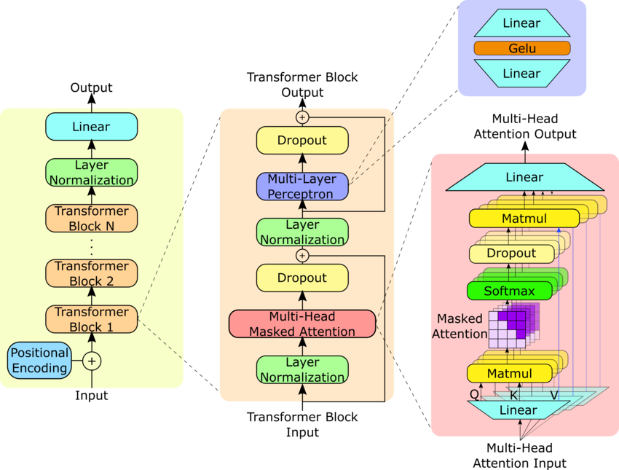
Architecture
Based on the GPT-2medium architecture.
Features a Transformer decoder structure.
Key Components:
Multi-head attention mechanism.
Trained end-to-end for optimized performance across various tasks.
GPT-2 Architecture (Yang et al., 2023)
Notes:
24 layers, 1024 hidden size, 16 attention heads.
Multi-head attention mechanism allows the model to focus on different parts of the input text.
347M parameters, enabling it to generate nuanced and contextually appropriate biomedical text.
Total parameters: 347M (difference from GPT-2 due to vocabulary size).
GPT2: 355M

Slide 15
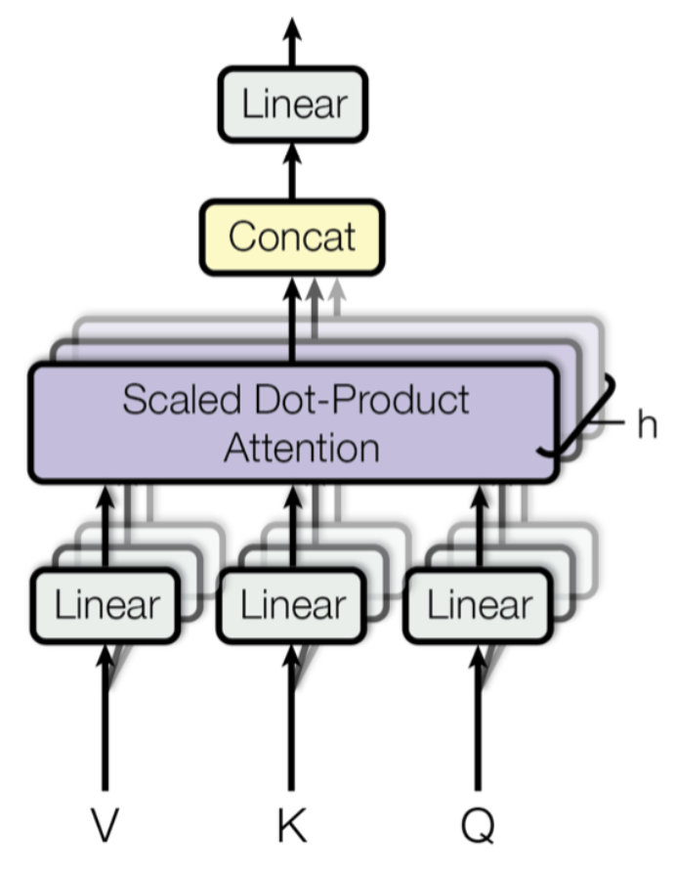
Multi-Head Attention Mechanism
Runs multiple attention mechanisms in parallel.
Outputs are concatenated and linearly transformed to match dimensions.
$Q,K,V$: Queries, Keys, Values.
$W$: Learnable parameter matrices.
$d$: Dimensionality scaling factor.
$$\begin{matrix}Multihead(Q,K,V) & =Concat(head_{1},head_{2},…,head_{h})W, \\ head_{i} & =softmax\left(\frac{Q_{i}K_{i}^{⊤}}{\sqrt{d}}\right)V_{i}\end{matrix}$$
Multi-Head Attention (Vaswani et al., 2017)
Notes:
Enables attention to different parts of the sequence.
Handles both long-term and short-term dependencies.

Slide 16
Training and Fine-tuning

Slide 17
Training Dataset
Pre-trained on 15M PubMed abstracts.
Enables training effective language models with domain-specific knowledge.
Bridge between general language understanding and biomedical text generation.
Key Characteristics:
Diverse range of biomedical topics.
Continuously updated with newly published research.
Notes:
BioGPT is pre-trained on a substantial dataset of 15 million PubMed abstracts.
Focus on high-quality, domain-specific biomedical texts.

Slide 18
Training
Pre-trained using standard language modeling tasks.
Criteria:
Minimize negative log-likelihood.
$D$: Dataset of sequences and $s_{j}$ : token
Effective batch size of 524,288 tokens.
Adam optimizer with a learning rate schedule.
Employed a warm-up phase(20,000 steps) to stabilize the training.
$$\begin{aligned}min-\frac{1}{|D|}\overset{|D|}{\underset{i=1}{∑}}\overset{n_{i}}{\underset{j=1}{∑}}logP(s_{j}|s_{j-1},s_{j-2},…,s_{1})\end{aligned}$$
Notes:
A learning rate schedule is a strategy to adjust the learning rate during training, typically decreasing it over time to ensure faster convergence in the early stages and finer adjustments in later stages, improving overall model performance and stability.
A step refers to a single update of the model's parameters after processing a batch of data.
An epoch is one complete pass through the entire training dataset.
Total steps( 500,000 steps.)
A warm-up phase refers to starting with a small learning rate that gradually increases over a specified number of training steps before reaching the desired learning rate. This helps stabilize training by preventing large, unstable weight updates early in the process when the model is still learning basic patterns.

Slide 19
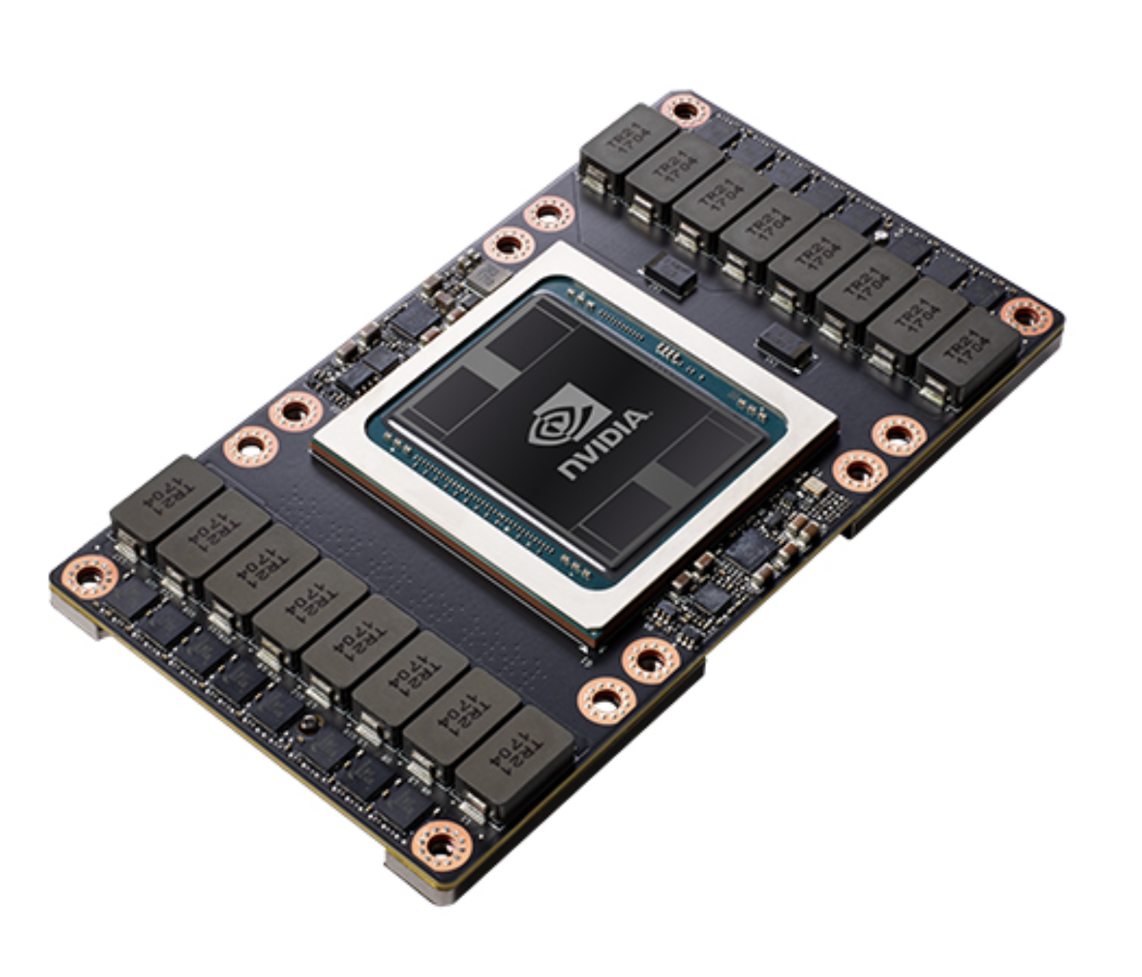
Training Hardware
Pre-trained on 8 NVIDIA V100 GPUs for 200,000 steps.
NVIDIA V100 FOR NVLINK, from NVIDIA website
Notes:
Only 1 GPU is used for fine-tuning it for downstream tasks tuning.

Slide 20
Vocabulary Development
Why Domain-Specific Vocabulary?
Language model’s performance hinges on its vocabulary quality.
General vocabularies can complicate specialized biomedical terms.
Vocabulary Creation Process
Byte Pair Encoding (BPE): Derives vocabulary directly from biomedical datasets.
Final Vocabulary Size: 42,384 tokens (50,257 for GPT)
Advantages:
Better understanding of biomedical terminology.
More precise and contextually relevant text generation.
Notes:
Vocabulary refers to the set of unique tokens (words, subwords, or characters) that a model recognizes and uses to process text.
Tokenization is a fundamental process in natural language processing (NLP) that involves breaking down a text sequence into smaller, more manageable units known as tokens.
BPE is a subword tokenization method that efficiently builds a vocabulary by splitting words into smaller units. It balances the need to represent rare words without having an excessively large vocabulary

Slide 21
Fine-tuning Method Overview
To adapt BioGPT for downstream tasks.
Key Adaptation:
Convert labels into natural language sequences.
Maintains consistency with pre-training task format.
Avoids structured formats or special tokens for smoother semantics.
Notes:
Fine-tuning is the process of taking a pre-trained model and further training it on a specific dataset or task to adapt it to the desired application.
To guide a language model to perform specific tasks by structuring input in a way that encourages the model to produce the desired output.
Tasks:
Relation extraction (end-to-end).
Question answering (QA).
Document classification.

Slide 22
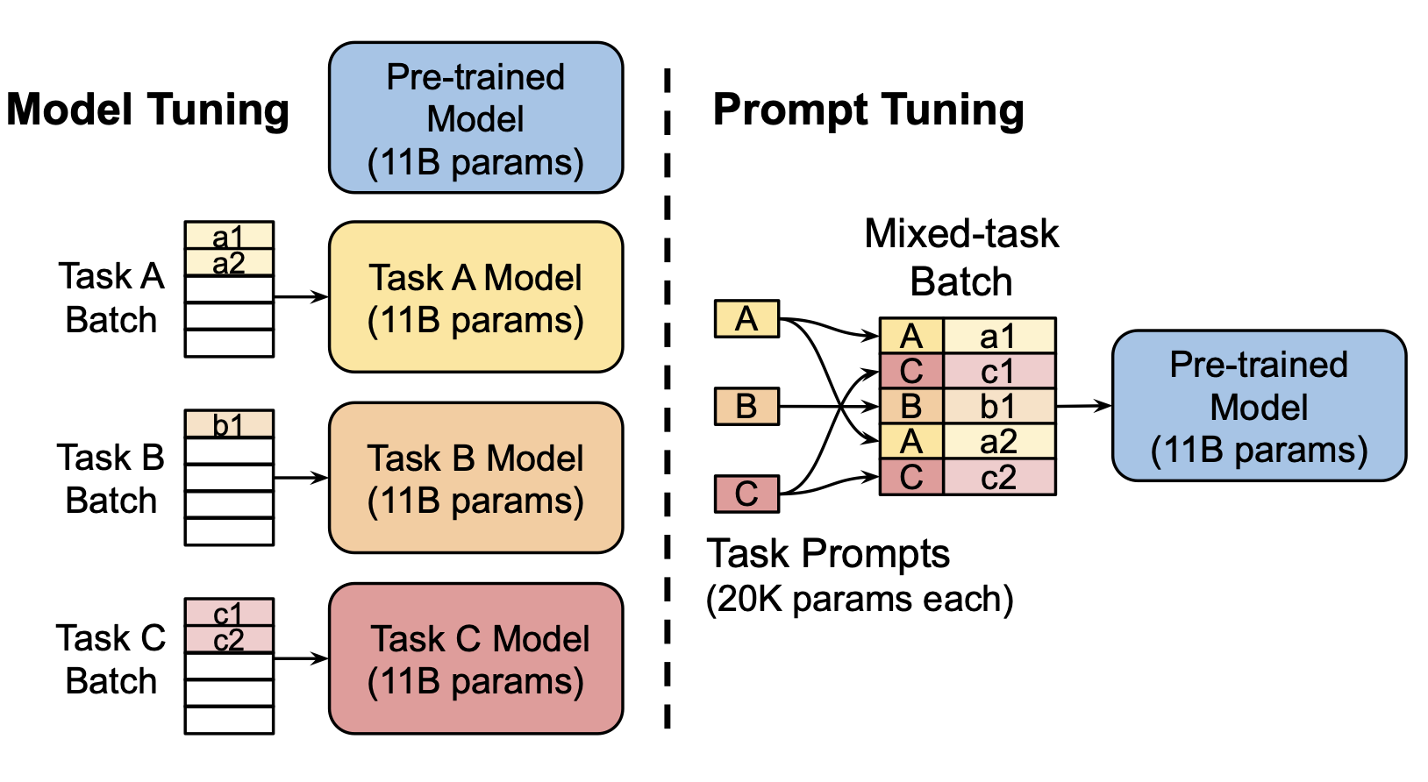
Prompt Based Fine-tuning Framework
Simply concatenating source and target is ineffective.
Workaround: prompts to guide the model in generating task-specific output.
Soft Prompts: Continuous embeddings (virtual tokens) learned end-to-end.
Virtual tokens are placed between source and target sequences.
Model Tuning vs Prompt Tuning (Lester et al., 2021)
Notes:
To guide a language model to perform specific tasks by structuring input in a way that encourages the model to produce the desired output.
Why Concatenation Fails
Simply combining “source”(context) and “target”(question/task) provides no clear guidance to the model.
Model struggles to understand the task during inference.
Hard Prompts : Manually designed text prompts (GPT3).
Pros: Can yield good results.
Cons: Labor-intensive and inconsistent performance across tasks.

Slide 23
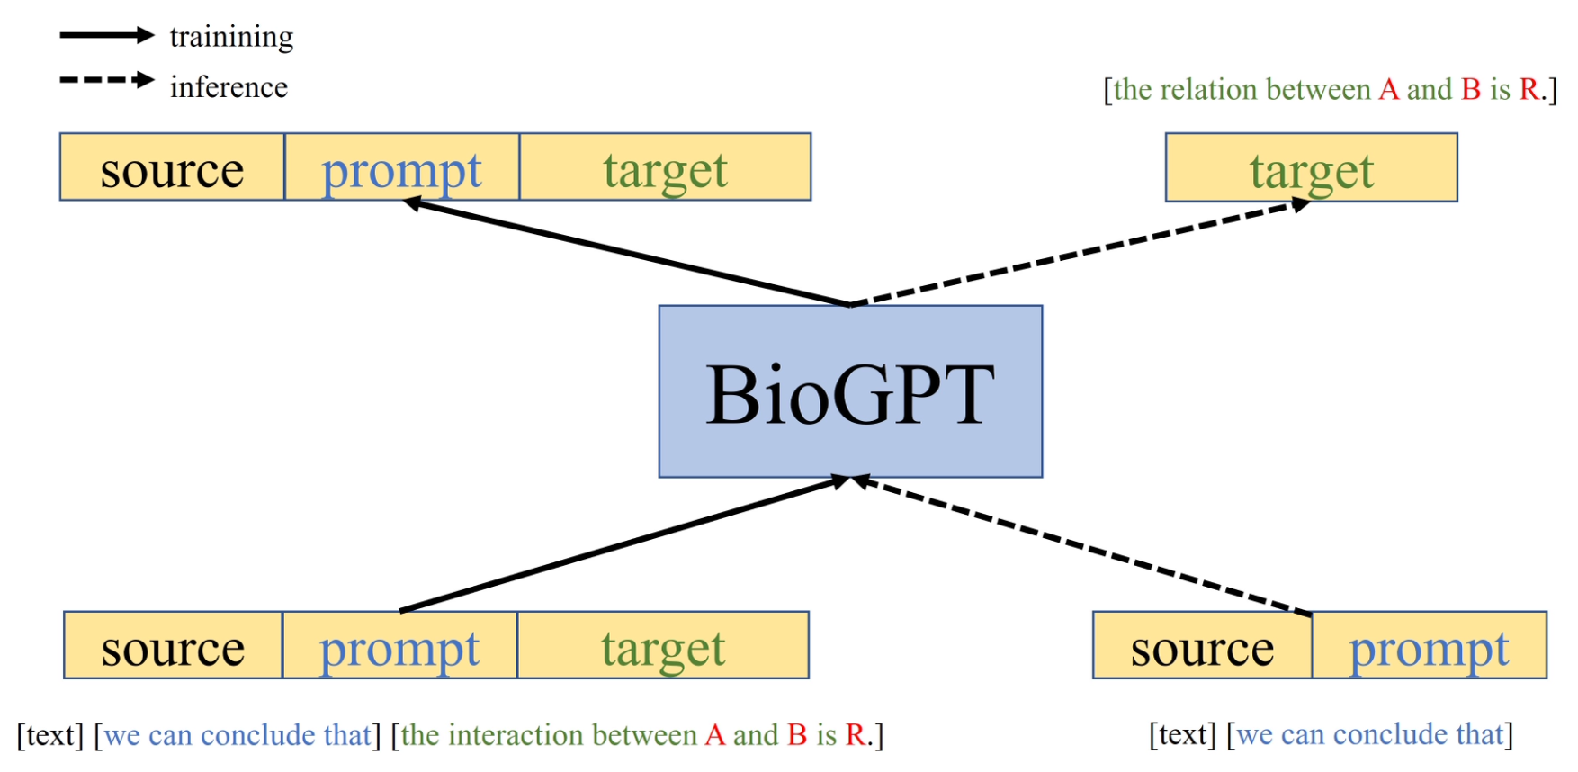
Prompt Based Fine-tuning Framework
Source: Paper
Notes:
Training vs. Inference:
Training: Model learns the [source; prompt; target] structure.
Inference: Model uses [source; prompt] to predict the target.
Diagram Explanation:
Solid Arrows: Indicate training input/output.
Dashed Arrows: Indicate inference flow.
Shows how BioGPT is conditioned by prompts to generate task-relevant responses.
Key Benefit: Soft prompts improve task alignment and output relevance without manual prompt design.

Slide 24
Downstream Tasks
Relation Extraction:
Key for biomedicine.
Focuses on generating relational triplets directly from text without intermediate annotations.
Question Answering (QA):
Answering questions based on context.
Produce answer sequences, improving upon span prediction methods.
Document Classification:
Classifying documents into predefined categories.
Leverages large pre-trained model for enhanced understanding and prediction.
Notes:
Relation Extraction:
Key for biomedicine; classical methods face issues with error accumulation.
Question Answering (QA):
Answering questions based on context.
Span prediction methods identify a specific portion (span) of text within a larger context that answers a question or fulfills a specific task.

Slide 25
Downstream Tasks
Task | Method | Dataset
Relation Extraction | GLRE, REBEL, seq2rel | KD-DTI, BC5CDR, DDI
Question Answering | QA-Net, LUKE, BERT, PubMedBERT, BioELECTRA, LinkBERT | PubMedQA, BioASQ
Document Classification | BERT, BlueBERT, SciBERT, SPECTER, PubMedBERT, BioELECTRA, LinkBERT | HoC, SciDocs
Summary of the downstream tasks for evaluation
Notes:
GLRE: Global-to-Local Relation Embedding captures both global context and local entity relationships for improved relation extraction tasks.
REBEL: A relation extraction model that uses a sequence-to-sequence framework for generating entity-relation triples directly from text.
Seq2Rel: Converts relation extraction into a sequence-to-sequence task, encoding entities and relations into structured outputs.
QA-Net: A question-answering model that uses convolutional networks and self-attention for faster and efficient extraction of answers from text.
LUKE (Language Understanding with Knowledge Embeddings): Incorporates entity-aware embeddings to improve performance on tasks like entity recognition and relation extraction.
BioELECTRA: A biomedical adaptation of the ELECTRA model, pre-trained for efficient token-level tasks like text classification and relation extraction in the biomedical domain.
Electra : Instead of masking tokens (like BERT), ELECTRA replaces some tokens in the input with incorrect ones (generated by a smaller generator model).
BC5CDR : Contains PubMed abstracts; Annotated for chemical-disease relations (e.g., identifying when a chemical causes or is associated with a disease).
KD-DTI : Annotated data indicating whether a particular drug interacts with a given target.
3. DDI : DDI refers to Drug-Drug Interaction,

Slide 26
BioGPT Variants
BioGPTlarge
48- layer Transformer
1.57B parameters
15M PubMed abstracts + 6M PMC full paper
Approx. 8B tokens
BioGPT
24-layer Transformer
347M parameters
15M PubMed abstracts
Approx. 4B tokens

Slide 27
Results

Slide 28
Relation Extraction Task
Extracting relationships between entities(triplets) in a single pass, without needing intermediate steps.
Model | Precision | Recall | F1
GLRE(gt+pred) | 34.82 | 18.29 | 23.99
GLRE(pred+pred) | 23.00 | 4.88 | 8.05
GPT-2 | 43.92 | 32.55 | 37.39
REBEL | 34.28 | 39.49 | 36.70
REBELpt | 40.94 | 21.20 | 27.94
Seq2rel | 43.5 | 37.5 | 40.2
BioGPT | 49.44 | 41.28 | 44.98
BioGPT⁺ | 49.52 | 43.25 | 46.17
Model | Precision | Recall | F1
Transformer + PubMedBERT-attn | 25.35 | 24.14 | 24.19
GPT-2medium | 30.53 | 27.87 | 28.45
REBEL | 32.36 | 29.58 | 30.39
REBELpt | 35.73 | 32.61 | 33.32
BioGPT | 40.00 | 39.72 | 38.42
Model | Precision | Recall | F1
GPT-2medium | 23.39 | 31.93 | 24.68
REBEL | 35.36 | 28.64 | 28.27
REBELpt | 46.59 | 39.60 | 40.56
BioGPT | 41.70 | 44.75 | 40.76
Results on BC5CDR chemical-disease-relation task
Results on KD-DTI drug-target-interaction task
Results on DDI drug-drug-interaction task
Notes:
Goal: Extract relational triplets like ⟨head entity, tail entity, relation⟩.
’†’ means training on training and validation set.
BC5CDR : Contains PubMed abstracts; Annotated at the token level for entity recognition and linked to identifiers in biomedical databasesAnnotated for chemical-disease relations (e.g., identifying when a chemical causes or is associated with a disease).
KD-DTI : Annotated data indicating whether a particular drug interacts with a given target.
3. DDI : DDI refers to Drug-Drug Interaction, which is the study and analysis of how two or more drugs interact with each other when administered together. It is a critical area in pharmacology and healthcare to ensure drug safety and efficacy.

Slide 29
2. Question Answering
Goal: Answer questions using reference context.
Labels: Yes, No, Maybe.
Model | Accuracy
PubMedBERT | 55.8
BioELECTRa | 64.2
BioLinkBERTbase | 70.2
BioLinkBERTlarge | 72.2
BioGPT | 78.2
Results on PubMedQA question answering task
Notes:
Source Sequence:
Prepend “question:” and “context:” to question and reference.
Example: question: question text; context: context text.
Target Sequence:
Generate: “the answer to the question given the context is label”.
Example: The answer to the question given the context is yes.

Slide 30
3. Document Classification
Goal: Classify document type based on text.
Target Sequence Format: The type of this document is ‘label’.
Model | F1
BioBERT | 81.54
PubMedBERT | 82.32
PubMedBERTlarge | 82.70
BioLinkBERTbase | 84.35
GPT-2medium | 81.84
BioGPT | 85.12
Results on HoC document classification task
Notes:
Classifying biomedical documents into predefined categories based on content.
HoC (Hierarchy of Concepts) is a dataset used for document classification in biomedical research, where scientific abstracts are categorized into a hierarchy of biomedical concepts (e.g., "apoptosis," "cell differentiation").
Useful for organizing large volumes of biomedical literature, aiding efficient research.
Example: The type of this document is genomic instability and mutation.
Demonstrates superior performance in understanding cancer-related literature.
They also evaluate on Text generating task, but there for that you do not need dataset, they compare it with GPT2, giving both of them same words to generate text.

Slide 31
Results Summary
Relation Extraction:
Drug-Target Interaction (KD-DTI)
Chemical-Disease Interaction (BC5CDR)
Drug-Drug Interaction (DDI)
Up to 4% improvement over all methods
Question Answering:
PubMedQA
6.0% improvement over previous best
Document Classification:
HoC
3.28% improvement over previous ones
Notes:
Knowledge Discovery DTI (Drug-Target Interaction) refers to the interaction between a drug (a chemical compound) and a biological target, such as a protein, enzyme, or receptor. Understanding these interactions is crucial in drug discovery and development because
Drug-Drug Interactions is a critical aspect of healthcare. happens when multiple drugs are used to treat complex or concurrent medical conditions, potentially leading to alterations in the way these drugs work. Leading to side effects
The DDI Extraction relies on the DDI corpus which contains MedLine abstracts on drug-drug interactions as well as documents describing drug-drug interactions from the DrugBank database.

Slide 32
BioGPT in Action

Slide 33

Drug-Target Interaction Extraction
The Janus family kinases (Jaks), Jak1, Jak2, Jak3, and Tyk2, form one subgroup of the non-receptor protein tyrosine kinases. They are involved in cell growth, survival, development, and differentiation of a variety of cells but are critically important for immune cells and hematopoietic cells. Data from experimental mice and clinical observations have unraveled multiple signaling events mediated by Jak in innate and adaptive immunity. Deficiency of Jak3 or Tyk2 results in defined clinical disorders, which are also evident in mouse models. A striking phenotype associated with inactivating Jak3 mutations is severe combined immunodeficiency syndrome, whereas mutation of Tyk2 results in another primary immunodeficiency termed autosomal recessive hyperimmunoglobulin E syndrome. In contrast, complete deletion of Jak1 or Jak2 in the mouse are not compatible with life and, unsurprisingly, do not have counterparts in human disease. However, activating mutations of each of the Jaks are found in association with malignant transformation, the most common being gain-of- function mutations of Jak2 in polycythemia vera and other myeloproliferative disorders. Our existing knowledge on Jak signaling pathways and fundamental work on their biochemical structure and intracellular interactions allow us to develop new strategies for controlling autoimmune diseases or malignancies by developing selective Jak inhibitors, which are now coming into clinical use. Despite the fact that Jaks were discovered only a little more than a decade ago, at the time of writing there are 20 clinical trials underway testing the safety and efficacy of Jak inhibitors.
Output: the interaction between pnus156804 and janus kinase 3 (jak 3) is inhibitor.
Structured Output: <pnus156804, janus kinase 3(jak 3), inhibator >
BioGPT
Task: Find <drug, target, interaction> triplet given the document

Slide 34
Drug-Drug Interaction Extraction
Output: the interaction between gemfibrozil and rosiglitazone is mechanism; the interaction between rifampin and rosiglitazone is mechanism.
Structured output: (gemfibrozil, rosiglitazone, mechanism), (rifampin, rosiglitazone, mechanism)
An inhibitor of CYP2C8 (such as gemfibrozil) may increase the AUC of rosiglitazone and an inducer of CYP2C8 (such as rifampin) may decrease the AUC of rosiglitazone. Therefore, if an inhibitor or an inducer of CYP2C8 is started or stopped during treatment with rosiglitazone, changes in diabetes treatment may be needed based upon clinical response.
BioGPT
Task : Find <drug, drug, interaction> triplet given the document

Slide 35
Question Answering
Question: Do some US states have higher / lower injury mortality rates than others?
Context: this article examines the hypothesis that the six u.s. states with the highest rates of road traffic deaths (group 1 states) also had above-average rates of other forms of injury such as falling, poisoning, drowning, fire, suffocation, homicide, and suicide, and also for the retail trade and construction industries. the converse, second hypothesis, for the six states with the lowest rates of road traffic deaths (group 2 states) is also examined. data for these 12 states for the period 1983 to 1995 included nine categories of unintentional and four categories of intentional injury, seventy-four percent of the group 1 states conformed to the first hypothesis, and 85% of the group 2 states conformed to the second hypothesis, answer: group 1 states are likely to exhibit above-average rates for most other categories of injury death, whereas group 2 states are even more likely to exhibit below-average rates for most other categories of injury death.
Ground truth: Yes
BioGPT: the answer to the question given the context is Yes.
Notes:
On PubMedQA dataset.

Slide 36
Zero-shot QA
Question: Can we measure mesopic pupil size with the cobalt blue light slit-lamp biomicroscopy method?
Context: [tl;dr: Some background introduction] The aim of this work is to assess a previously described slit-lamp biomicroscopy-based method (SLBM) for measuring pupil diameter and compare it to Colvard infrared pupillometry (CIP). Two examiners performed three repeated measurements with each instrument in 40 healthy eyes. We determined the agreement of SLBM and CIP, intraobserver and interobserver repeatabilities, and interobserver concordance (kappa) and SLBM ability for detecting pupil sizes over 6.0 mm. The mean (±standard deviation [SD]) pupil diameter was 5.81 ± 0.70 mm with SLBM and 6.26 ± 0.68 mm with CIP (p=0.01) averaging both examiner's results. Mean differences between the SLBM and CIP were -0.60 mm and -0.30 mm for each examiner using the average of the three readings (p=0.02), and they were very similar using the first reading. Intraobserver reproducibility: the width of the 95% LoA ranged from 1.79 to 2.30 mm. The ICCs were 0.97 and 0.92 for SLBM, and 0.96 and 0.90 for CIP. Interobserver reproducibility, the width of the LOA ranged from 1.82 to 2.09 mm. Kappa statistics were 0.39 and 0.49 for the first and mean SLBM readings, respectively, and 0.45 for both the first and mean CIP readings. Sensitivity and specificity of SLBM for detection of pupils larger than 6 mm ranged from 55.56% to 73.68% and from 76.19% to 95.45%, respectively. The best tradeoff between sensitivity and specificity ranged from 5.4 mm to 6.2 mm.
Ground truth: No
BioGPT: The answer is that SLBM is not a good alternative to CIP for measuring pupil size.
Notes:
Zero shot meaning model has never seen this data or context while it was trained.

Slide 37
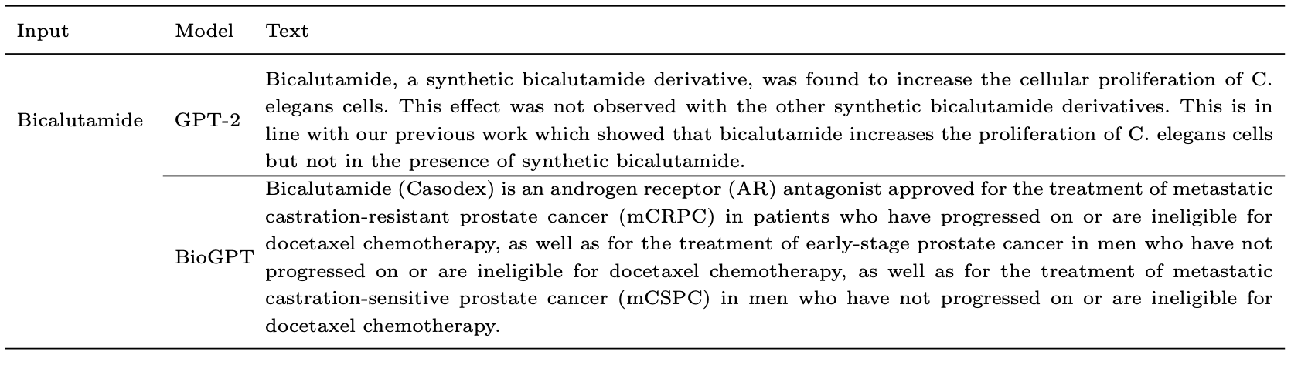
Text Generation
Common Words
GPT-2 vs BioGPT when given relatively common names as input
Notes:
Involves generating coherent biomedical text based on prompts or keywords.
Aids in creating abstracts, summaries, and descriptions for research papers.
BioGPT's generated texts were compared to standard GPT-2 outputs.
BioGPT produces more contextually relevant and coherent biomedical descriptions.
Highlights BioGPT’s enhanced generative capabilities in the biomedical domain.

Slide 38
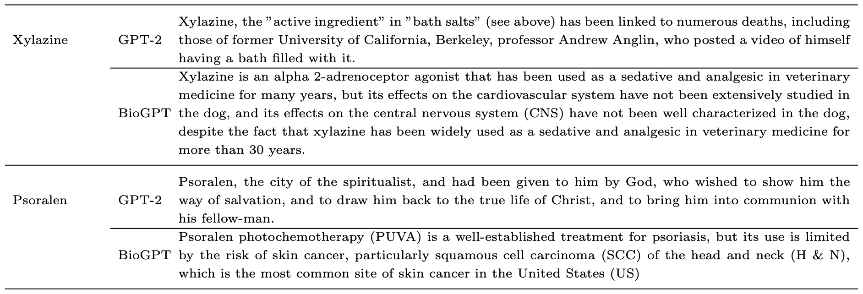
Text Generation
Uncommon Words I
GPT-2 vs BioGPT when given somewhat uncommon names as input
Notes:
GPT goes all theological in second word.

Slide 39
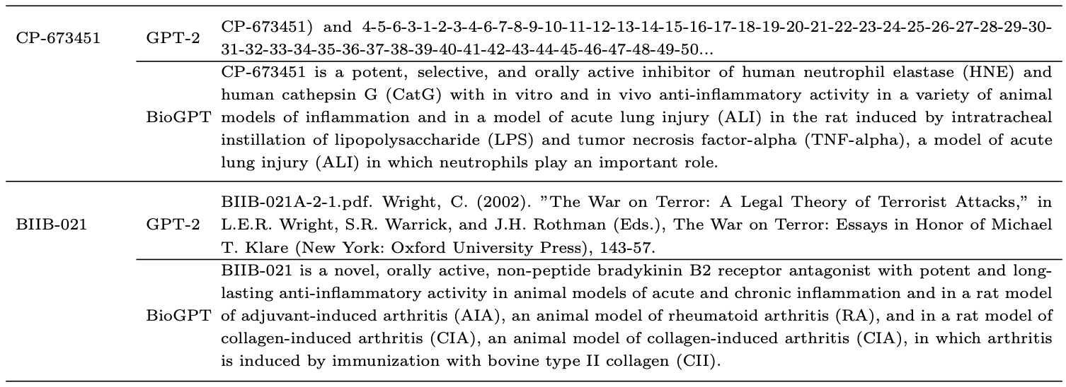
Text Generation
Uncommon Words II
GPT-2 vs BioGPT when given somewhat uncommon names as input

Slide 40
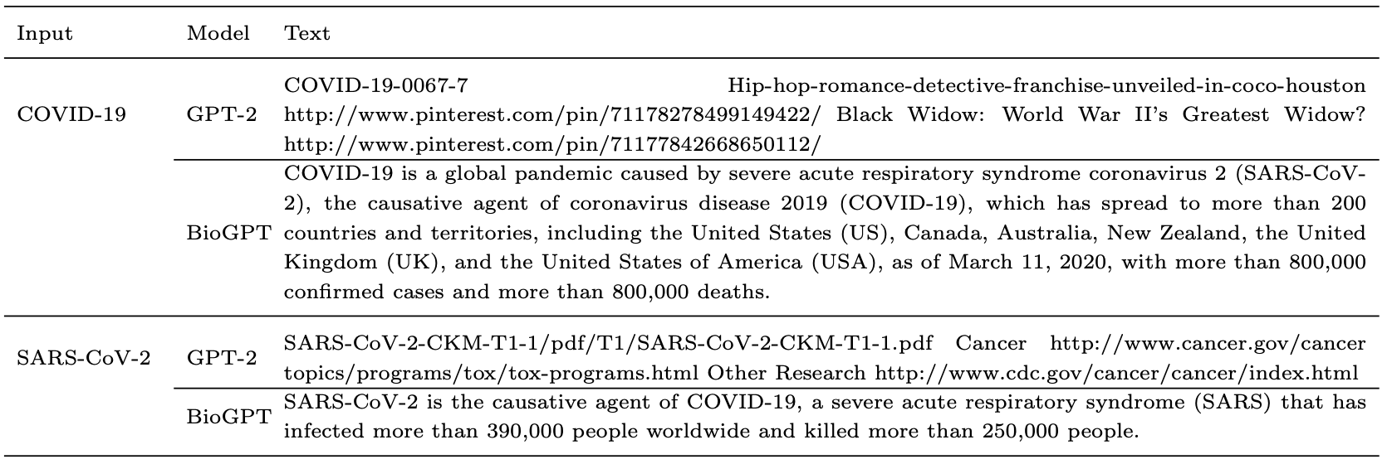
Text Generation
Keywords of interest
GPT-2 vs BioGPT when manually given keywords of interest (COVID-19 related terms)

Slide 41
Scaling to Larger Size
BioGPTlarge
Developed on GPT-2 XL architecture, 1.5B parameters.
Fine-tuned and evaluated for enhanced performance on downstream tasks.
Task | Metric | Performance
BC5CDR | F1 | 50.12
KD-DTI | F1 | 38.39
DDI | F1 | 44.89
PubMedQA | Accuracy | 81.0
HoC | F1 | 84.40
BioGPT-Large fine-tuned on downstream tasks
Notes:
GPT-2 XL : The largest version of GPT-2

Slide 42
Conclusion
Built on the GPT-2 backbone, pre-trained on 15M PubMed abstracts.
Pioneer to adapt GPT effectively in Biomedicine domain.
Outperforms GPT-2 in biomedical text generation.
State-of-the-Art results on:
3 relation extraction tasks.
1 question answering task.
Larger-scale BioGPT model on expanded biomedical datasets.

Slide 43
References
https://arxiv.org/pdf/2210.10341
https://pubmed.ncbi.nlm.nih.gov/
https://www.semanticscholar.org/
https://arxiv.org/pdf/2409.00133
https://vitalflux.com/bert-vs-gpt-differences-real-life-examples/
https://www.researchgate.net/figure/GPT-2-model-architecture-The-GPT-2-model-contains-N-Transformer-decoder-blocks-as-shown_fig1_373352176
https://arxiv.org/pdf/1706.03762
https://www.nvidia.com/de-de/data-center/

Slide 44
Any Questions?
Thank you for listening!

